Slide 1
Production Planning and Scheduling system Analytics using Tableau and Python – MGT 809B
Jianxiang Zhai
Apoorv Akhouri
Business Intelligence & Analytics
School of business
Under the guidence of Prof. Alkiviadis Vazacopoulos

Slide 2
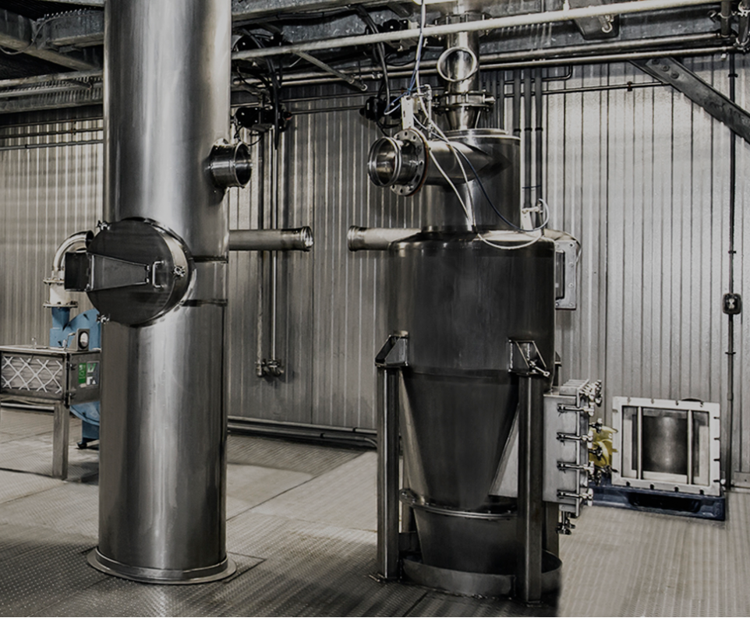
Overview
Our group’s responsibility is to develop a Visualization and machine learning tool to study Spray-Tek’s current Scheduling system.

Slide 3
Problem statement
The company has 10 dryers. The performance of three process time is unbalanced among them.
Some of the customer items are splitted into batches.
Drying quantity needs to be further analyzed to understand other attributes more clearly.

Slide 4
Potential solutions /Tools
Tool used: Python, Tableau
Tableau
Analyze Data
Count of duplicated customer item number.
Visualize Comparisons between batch number and distinct customer item number.
Correlation between the different process times & other attributes of the dataset.
Python
Data EDA
Use total work time / yield percentage as KPI to rate each dryer.
Segregate the data into 4 subsets using K-Prototype, based on drying quantity.
Compare the clusters against a new column created i.e., Rate. [ActualDryQty / TotalRunTime_hrs]
Dashboards of tableau are interactive and using the filters filter conditions can provide insights.

Slide 5
Data Structures
Set data to a specific scale
Dryer: 01/03
10 Dryers but 11 and 5 are excluded
8 production lines in total:
Flavor
Fragrance
Chemical
Cosmetic
Food additive
Nutraceutical
Pharma
Vtamin
Visualization and analyze
concentrate
Production line: Flavor/Fragrance
Time scale:
Dec/2020
Data from 2016 to 2020

Slide 6
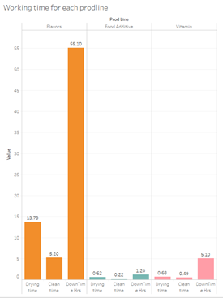
Working process
Data visualization
The figure explains the dryer 1’s performance which concentrates on Flavors.
The downtime take most of the time. Insight for Spray-Tek: Analyze type of customer

Slide 7
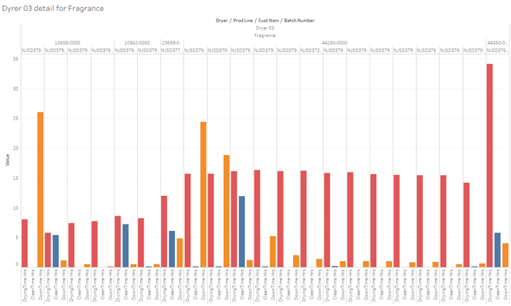
General working time
Data visualization
Working times are displayed by each batch number followed by corresponding customer item number.
Insight for Spray-Tek: 44190-0000 Customer_Item, they have almost the same drying time but first two of them have increased downtimes.

Slide 8
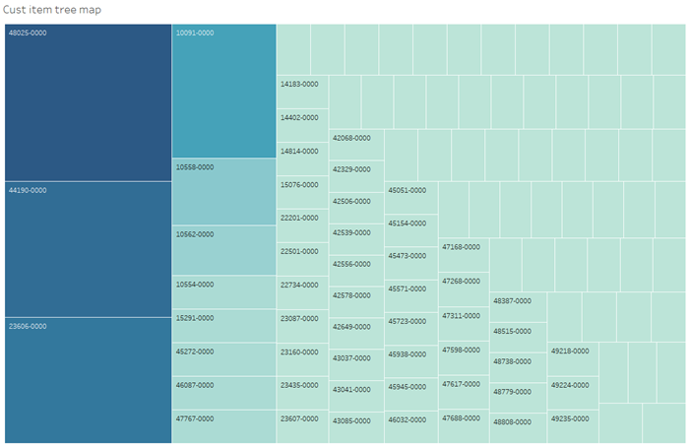
Customer item Heatmaps
Data visualization
The Heatmap describes which customer item number orders are divided into batches.
Insight: The heat map can also be filtered by dryer.

Slide 9
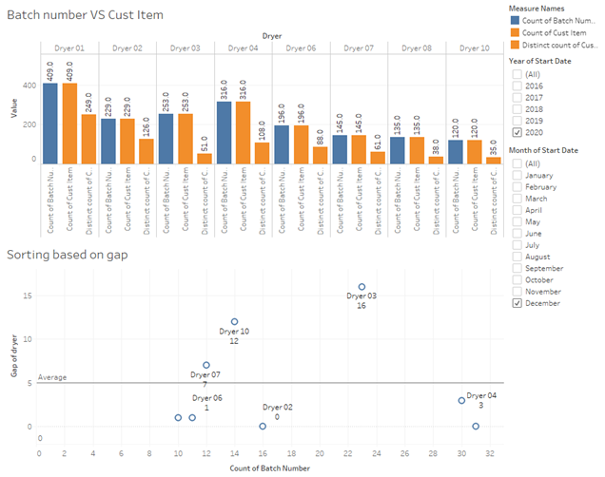
Batch number VS Customer item
Data visualization
The gap means the difference between batch number and unique customer item.
Insights: For dryers greater than 5
divided dryer
For dryers below 5
balanced dryer.

Slide 10
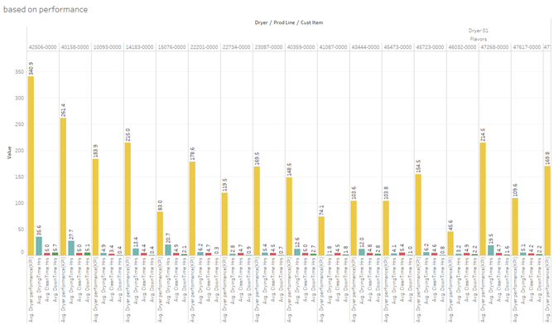
Dryer performance
Data visualization
The dryer performance is rated based on Actual dry quantity / Yield percentage.
Insight: The company can look directly to a divided/balanced dryer about the working times for a high rated customer item number, and low rated also.

Slide 11
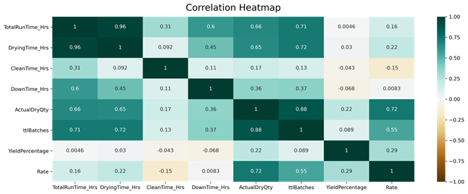
Correlation Heatmap
Python processing
Heatmap explains what connection might be observed between these attributes.
DownTime & CleanTime seem to show the characteristics of being independent factors which are influenced by none of the other attributes. They are fixed processes which show no pattern & thus no correlation with the other attributes.
Although, TotalRunTime is seen to be most affected by DryingTime & also ttlBatches (Total Number of Batches) up to a certain extent.

Slide 12
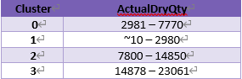
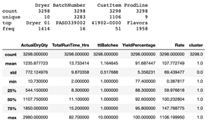
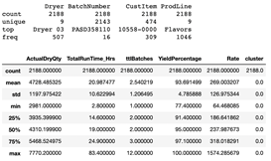
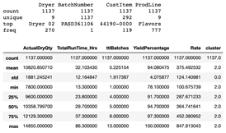
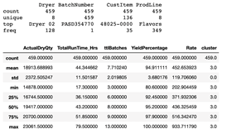
Clustering
Python processing
Clustering by K-Prototype
This DataFrame is converted to a numpy array.
We instruct our K-Prototype to set up 4 clusters & run it for 50 iterations.
We then passed our numpy array to a fit & predict method offered by the K-Prototype algorithm.
As instructed, K-prototype forms 4 clusters named 0, 1, 2, 3 & assigns each to each row of data.

Slide 13
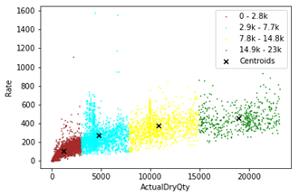
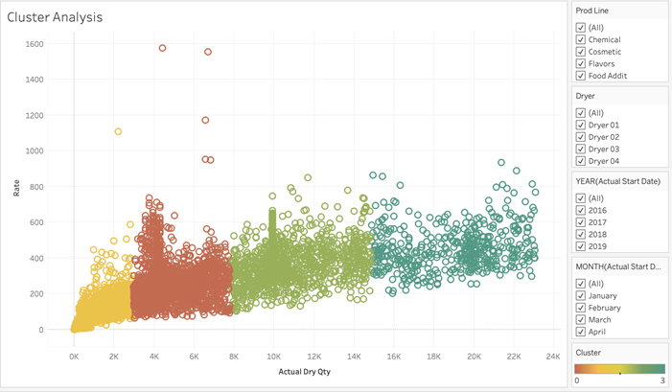
Clustering visualization
Python processing
This comparison is re-modeled on Tableau to provide the company a template where they can filter out years, months, dryers & production line according to their requirements & understand the characteristics the data is trying to show. Later we can use these 4 clusters for DEA so we can obtain an Efficiency Frontier that other dryers can look at for better processing.
We can notice that our lowest cluster i.e., 0 – 2.8k ActualDryQty has its centroid closer to zero.
We can say that we will see more values in this cluster closer to the lower whisker. Something similar can be said about our second cluster i.e., 2.9k – 7.7k ActualDryQty. Meanwhile, we notice that our third & fourth clusters seem to be quite well distributed.

Slide 14
Summary
Our strategy is to restrict the time scope to a specific scale and use control variable to analyze the batch processing.
Simultaneously, we use clustering to gain a deeper understanding of the operations & how the dryers, process times, yield & rate react to different drying quantities.

Slide 15
Thank you
Any questions?

